Slide 1
API Gateway Pattern
An API Gateway is basically an interface in which it receives calls and redirects to internal services(Microservices).
When building a large and complex system using the microservices architecture with multiple client apps, a good approach to consider is API Gateway Pattern.
When building microservices-based applications, an API Gateway is needed to have a central place where authentication, routing, orchestration, etc., is implemented.
This pattern provides a single entry-point for group(s) of microservices.
Without an API Gateway in place, you might typically implement each of these in each service, and hence maintaining them for each service would be a daunting task at hand.
An API Gateway decouples the service producer from its consumer, providing a security layer since you need not expose your microservices directly.
The API Gateway sits between the client apps and the microservices.
It can also provide additional cross-cutting features such as Routing, Authentication, Service discovery, Logging .

Slide 2
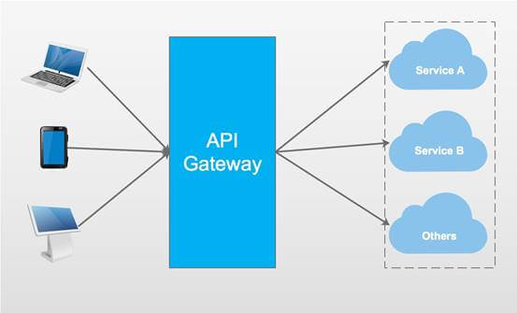
Building API Gateway Using Ocelot In ASP.NET Core

Slide 3
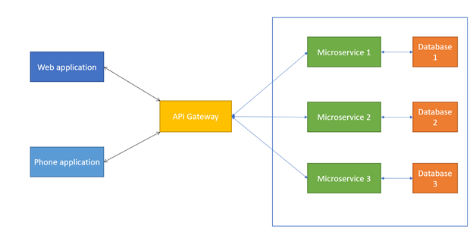
Building API Gateway Using Ocelot In ASP.NET Core

Slide 4
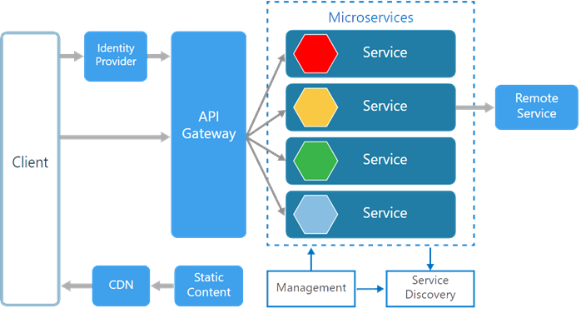
Building API Gateway Using Ocelot In ASP.NET Core

Slide 5
Building API Gateway Using Ocelot In ASP.NET Core
Ocelot is an Open Source API Gateway for the .NET/Core Platform.
Ocelot unifies multiple microservices so that the client does not have to worry about the location of each and every Microservice.
Ocelot API Gateway transforms the Incoming HTTP Request from the client and forward it to an appropriate Microservice.
Ocelot is widely used by Microsoft and other tech-giants as well for Microservice Management.

Slide 6
Ocelot In ASP.NET Core
Ocelot Features
Routing the Incoming Request to the required Microservice
Authentication
Authorization
Load Balancing
Logging
Service Discovery with Consul & Eureka
Service Fabric
Caching

Slide 7
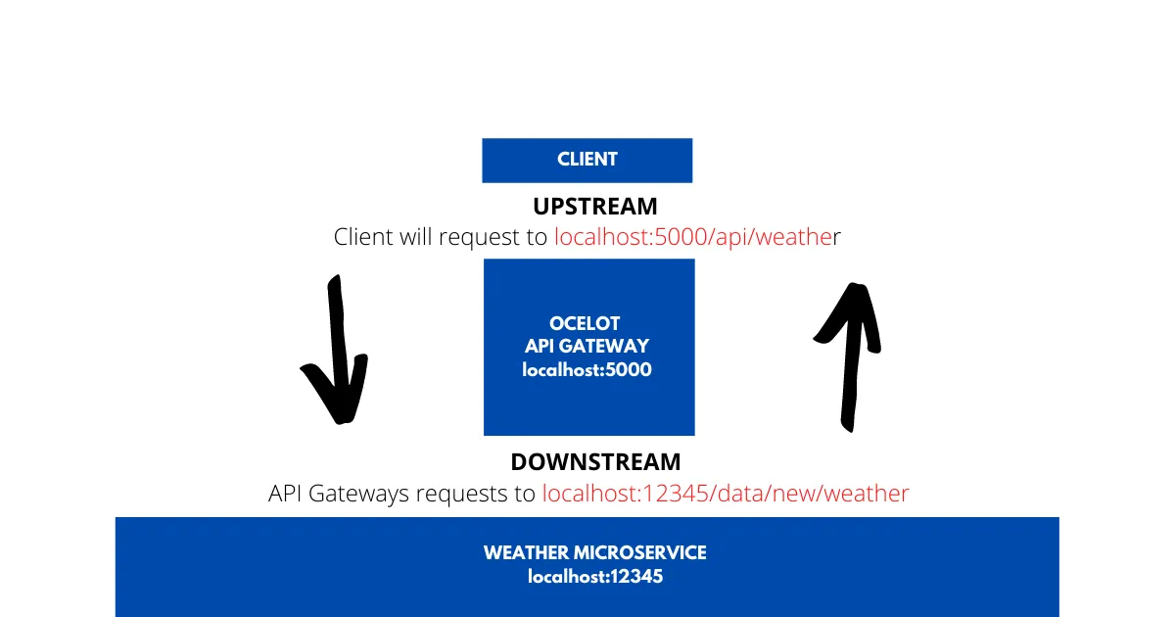
Ocelot In ASP.NET Core
It will be as easy and installing the Ocelot package to your API Gateway project and setting up a JSON Configuration file that states the upstream and downstream routes.
Upstream and Downstream are 2 terms that you have to be clear with.
Upstream Request is the Request sent by the Client to the API Gateway. Downstream request is the request sent to the Microservice by the API Gateway. All these are from the perspective of the API Gateway.

Slide 8
Configuring Ocelot Routes
{
"Routes": [
{
"DownstreamPathTemplate": "/api/product",
"DownstreamScheme": "https",
"DownstreamHostAndPorts": [
{
"Host": "localhost",
"Port": 44337
}
],
"UpstreamPathTemplate": "/gateway/product",
"UpstreamHttpMethod": [ "POST", "PUT", "GET",”Delete” ]
}
]
}
Ocelot takes in an Array of Route Objects.

Slide 9
Configuring Ocelot Routes
DownstreamPathTemplate denotes the route of the actual endpoint in the Microservice.
DownstreamScheme is the scheme of the Microservice, here it is HTTPS
DownstreamHostAndPorts defines the location of the Microservice. We will add the host and port number here.
UpstreamPathTemplate is the path at which the client will request the Ocelot API Gateway.
UpstreamHttpMethod are the supported HTTP Methods to the API Gateway. Based on the Incoming Method, Ocelot sends a similar HTTP method request to the microservice as well.

Slide 10
Configuring Ocelot Routes
{
"Routes": [
{
"DownstreamPathTemplate": "/api/product/{catchall}",
"DownstreamScheme": "https",
"DownstreamHostAndPorts": [
{
"Host": "localhost",
"Port": 44337
}
],
"UpstreamPathTemplate": "/gateway/product/{catchall}",
"UpstreamHttpMethod": [ "GET", "DELETE" ]
}
]
}
We are accepting any Parameter in the route. We restrict the methods to just GET and DELETE

